Slide 1
Chapter 9: Intelligence Tests

Slide 2
The ABCs of Intelligence (1 of 11)
Tests: the way people behave.
Purpose of intelligence tests.
Intelligence?
The theory behind the intelligence tests.
Notes:
Tests: the way people behave:
No social or behavioral scientist has ever seen intelligence.
The existence of intelligence is inferred by the way of people behave.
The way people behave is called as tests.
Purpose of intelligence tests:
The original and substantial purpose of intelligence tests is to predict how well one does in school and therefore they are aptitude tests.
The ability to solve problems, think analytically, process information, remember well and comprehend the world are all important for a good student.
Therefore, intelligence tests measure these abilities.
They are built from bunches of subtests that tap into those sorts of constructs and these tests are called intelligence tests because it seems reasonable to combine all these abilities while measuring intelligence.
For this purpose of the tests, predicting school performance, intelligence tests have very good criterion-based validity.
Intelligence: the capacity of an individual:
There are several theories of the structure of intelligence and several tests based on them.
Commonly, it is defined as the global capacity of a person to act purposefully, to think rationally, and to deal effectively with the environment.
The theory behind the intelligence tests: Intelligence can be considered as a construct or a group of related variables (such as verbal skills, memory, mechanical skills, comprehension) and has some theoretical basis to it.

Slide 3
The ABCs of Intelligence (2 of 11)
The Big g
The g factor or the general-factor theory.
The s’s or the specific intelligences.
Notes:
The g factor or the general-factor theory:
One of the first conceptualizations of intelligence was proposed by Charles Spearman.
He believed that underlying all intelligent behavior is a general factor that accounts for explaining individual differences between people in terms of acting smart.
He named the actual factor g to represent general intelligence.
According to Spearman, there is one type of intelligence that accounts for individual differences between people.
The s’s or the specific intelligences:
Since not everyone with a high g could do everything well, Spearman recognized that there are other factors that are specific in their nature.
These factors were called the s’s and were used to represent specific types of intelligences.
The theory focused on representing intelligence as the general factor with a bunch of s’s floating around and these other factors are related to one another to varying degrees.

Slide 4
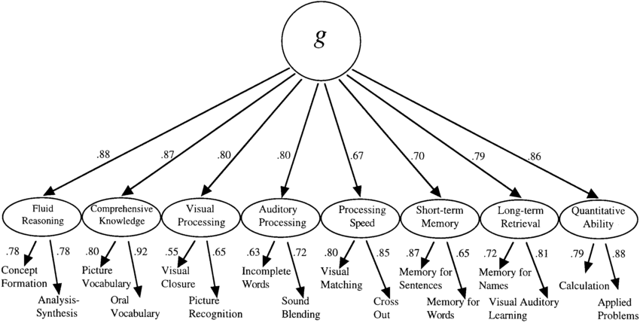

Slide 5
The ABCs of Intelligence (3 of 11)
The debate about the big g.
The probability of an underlying trait.
Notes:
The debate about the big g:
There are several ongoing debates about whether intelligence is best represented by the big g (for a general underlying ability) or a small s (for some specific abilities).
While there is no answer to the debate, it fuels new ideas and approaches to the assessment of intelligence.
The probability of an underlying trait:
When intelligence is broken down, the subtests on intelligence tests tend to correlate with each other.
This suggests that there is probably an underlying trait accounting for a substantial proportion of intelligence.

Slide 6
The ABCs of Intelligence (4 of 11)
More Than Just the Big g: The Multiple Factor Approach
Different types of intelligence.
The basis of Primary Mental Abilities Test.
The invention and purpose of factor analysis.
Notes:
Different types of intelligence:
Spearman’s idea of one general factor did not fit other models and ideas.
Some others like Louis Thurstone thought that there were different types of intelligence.
Primary mental abilities: verbal ability, spatial ability, and perceptual speed; Thurstone stated that these abilities are independent of each other.
The basis of Primary Mental Abilities Test:
It may be tough to find sets of human behaviors or attributes or abilities that are unrelated to one another.
Thurstone’s theory has been the basis for a widely used test of intelligence, the Primary Mental Abilities Test.
The test has appeared in many different forms since the late 1930s.
The invention and purpose of factor analysis:
To verify whether intelligence was one factor or several, the invention of a powerful statistical strategy called Factor Analysis happened.
Factor analysis was created and refined and has been used ever since in the development and verification of many different tests of intelligence.

Slide 7
The ABCs of Intelligence (5 of 11)
More Than Just the Big g: The Multiple Factor Approach
Use of factor analysis to group variables.
Purpose: looking at the correlations among many variables.
Notes:
Use of factor analysis to group variables:
Factor analysis can be used to determine which of a set of variables can be grouped together to form a conceptually sound unit (called a factor).
For instance, consider two different tests that examine one’s ability to assemble puzzles and another to build three-dimensional objects.
The two tests may be reflections of a factor called spatial ability.
If the two tests share something in common across many individuals or do not share something in common with reading skills or other factors that are not related to one another, then there may be a factor that can stand on its own (is independent), and an element of the theory of intelligence.
The purpose of factor analysis:
Factor analysis essentially looks at the correlations among a bunch of variables.
It looks for some items that group together and correlate more with each other than they do with other variables.
When they do, correlate more with each other than they do with other variables.
The analysis is used to validate theories of intelligence as well as to study many different phenomena in the social and behavioral sciences and is well worth knowing about.

Slide 8
The ABCs of Intelligence (6 of 11)
“Book Smart” or “Street Smart” debate
Learning vs. solving
The Horn-Cattell model breaks theory into two aspects.
Cattell-Horn-Carroll theory.
Notes:
The two types of smart:
Intelligence researchers sometimes think there seems to be two ways of being smart.
One way of being smart focusses on learning information and “knowing stuff” .
Another type of being smart is all about solving puzzles and figuring out solutions to problems.
The Horn-Cattell model breaks theory into two aspects:
A theory of intelligence called the Horn-Cattell model breaks intelligence down into the two aspects of being intelligent.
The book smart component of stored knowledge is called crystallized intelligence.
The street-smart component of problem solving and being able to learn new skills is referred to as liquid intelligence.
There is much research to support the formulation which is widely accepted by many.
Cattell-Horn-Carroll theory: This broader framework which is the expanded version of the Horn-Cattell model includes a general g which seems to underlie performance across all cognitive skills tests.

Slide 9
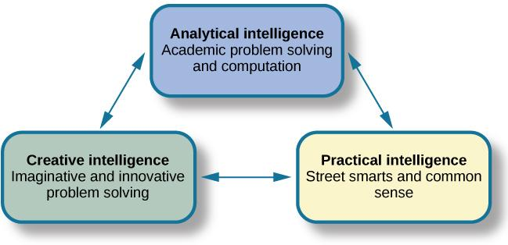
The ABCs of Intelligence (7 of 11)
Sternberg’s Triarchic Theory of Intelligence
Notes:
Triarchic theory of intelligence:
Formulated by Robert Sternberg, it postulates several “types” of intelligence or cognitive abilities.
The theory explain intelligence through an understanding of how people think about and solve problems, which is the information-processing approach.
Sternberg stated that to understand intelligence and how people differ from one another, the interaction between componential, experiential, and contextual intelligence must be considered.
Componential intelligence focuses on the structures that underlie intelligent behavior, including the acquisition of knowledge. It’s what you know. (Analytical)
Experiential intelligence focuses on behavior based on experiences. It’s what you did. (Creative)
Contextual intelligence focuses on behavior within the context in which it occurs and involves adaptation to the environment, selection of better environments, and shaping of the present environment. It’s how you behave (Practical)
The basis of the theory: While developing this approach, Sternberg attempted to base the theory on the interaction between the individual’s skills and abilities and the demands placed on that individual by the environment.

Slide 10

The ABCs of Intelligence (8 of 11)
Howard Gardner’s Multiple Intelligences
  Musical intelligence.
  Bodily kinesthetic intelligence.
  Logical-mathematical intelligence.
  Linguistic intelligence.
Notes:
Howard Gardner’s model of multiple intelligences: As research on intelligence became more sophisticated and included findings from fields such as neuroscience and developmental psychology, the newer theories placed increased significance on everyday behavior.
The eight different types of intelligence:
Musical intelligence includes the ability to compose and perform music.
Bodily kinesthetic intelligence includes the ability to control one’s bodily movements.
Logical-mathematical intelligence includes the ability to solve problems.
Linguistic intelligence includes the ability to use language.

Slide 11
The ABCs of Intelligence (9 of 11)
  Spatial intelligence.
  Interpersonal intelligence.
  Intrapersonal intelligence.
  Naturalist intelligence.
Notes:
Spatial intelligence includes the ability to manipulate and work with objects in three dimensions.
Interpersonal intelligence includes the ability to understand others’ behavior and interact with other people.
Intrapersonal intelligence includes the ability to understand ourselves.
Naturalist intelligence includes the ability to identify and understand patterns in nature.

Slide 12
The ABCs of Intelligence (10 of 11)
Assumptions made by Gardner.
Gardner’s take on assessment.
Developing the intelligence profile of students.
Notes:
Assumptions made by Gardner:
Gardner assumes that everyone has each of these intelligences to some degree.
Every individual is stronger in some intelligences than others, and that some or most people excel in one.
Gardner’s take on assessment:
Gardner would suggest that traditional tests of intelligence do not provide the flexibility needed by the test taker to show his or her skills across this very broad range.
Gardner emphasizes the importance of individual differences in the assessment of these eight intelligences.
This has been discussed by psychometricians such as Frances Galton almost a century earlier
Developing the intelligence profile of students: This can be done through student portfolios and the use of independent projects and journals.

Slide 13
The ABCs of Intelligence (11 of 11)
Emotional Intelligence:
The ability to be sensitive and manage emotions.
Self-awareness more important than IQ.
Evaluation of emotional intelligence.
Notes:
Emotional intelligence:
Daniel Goleman popularized the idea of emotional intelligence.
It is the ability to be emotionally sensitive to others and to manage and understand our own emotions and solve problems involving emotional issues.
Self-awareness more important than IQ:
In his book, Goleman argues that characteristics such as self-awareness and persistence are more important than IQ.
He believed that children should be taught how to identify their own and others’ emotions and that these are the skills that make real-world people successful, regardless of their traditional level of intellect.
Evaluation of emotional intelligence:
Perhaps emotional intelligence is not meant to be evaluated in the more traditional way.
Instead, one may depend on skills such as observation and keeping journals and other ways.
While less objective, these are surely richer ways of assessing outcomes.

Slide 14
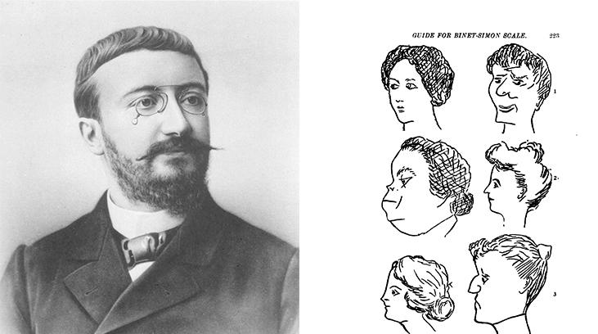
ALFRED BINET
Notes:
French psychologist Alfred Binet helped to develop intelligence testing. (b) This page is from a 1908 version of the Binet-Simon Intelligence Scale. Children being tested were asked which face, of each pair, was prettier

Slide 15
The Stanford–Binet Intelligence Scale (1 of 6)
The troubling finding about intelligence.
Unclear reasons behind differences in intelligence.
Examining the Stanford-Binet.
Notes:
The troubling finding about intelligence:
Undoubtedly, intelligence is a very complex construct that is difficult to define and difficult to measure.
A troubling finding about intelligence has been that there are often average score differences between racial and ethnic groups and, sometime on certain subtests, differences between sexes.
Unclear reasons behind differences in intelligence:
The reason behind the presence of such differences in intelligence is unclear.
This is because there is no important biological differences in the physical brain at birth between races or genders.
Most researchers reasonably conclude that the cause of these differences must be cultural.
The differences may reflect the way the test is constructed, and the way items appear on the test.
The content and format of tests reflect the test developers’ orientation and definition of intelligence, and those things are all culturally determined.
Therefore, the tests may be biased toward the culture of the test designers in that way.
Examining the Stanford-Binet:
The Stanford–Binet is one of the most popular intelligence tests.
Examining the test can help to get an overall picture of how such a test is developed, how it is used, and how unquestioned assumptions within one’s culture can shape the view on what intelligence is and how it should be measured.

Slide 16
The Stanford–Binet Intelligence Scale (2 of 6)
A Bit of History of the IQ
Close ties between Simon and Piaget.
Piaget’s definition of intelligence.
Combined efforts of Simon and Binet.
Replacing terms denoting intelligence.
Notes:
The close ties between Simon and Piaget:
Around 1905, Parisian Theodore Simon was doing some work in the area of reading.
Simon had close ties with the famous developmental psychologist Jean Piaget.
Piaget’s experience with Simon led to Piaget speculating about the successes and failures of children.
This led to Piaget’s famous work on cognitive development and epistemology.
Piaget’s definition of intelligence:
Jean Piaget was one of the foremost and most productive cognitive developmental psychologists.
His definition of intelligence grew from much of his work in France and his later work with his own children.
According to Piaget, those acts showing intention were intelligent acts.
His definition of intelligence directly reflects his own theoretical views on development and the development of intelligence.
Combined efforts of Simon and Binet:
Piaget was increasingly intrigued by the nature of the failure to read among “normal” children and during the same time Simon was working with Alfred Binet to develop a test to predict and distinguish between those who would do well in school and those who would not.
The result of Simon and Binet’s efforts was the first 30-item intelligence scale that was used to identify children who were “mentally retarded” .
Replacing terms denoting intelligence:
Earlier, terms like “imbecile” and “idiot” were used all the time in the old days to talk about intelligence.
But today, less insulting terms such as typically developing or intellectual disability are in place.
The questions and tasks in the test were substantially chosen by classroom teachers.
At first, the items were arranged by difficulty, and then later, the arrangement was by age level.
So, in addition to having a chronological age for the child, the test results also yielded a mental age.

Slide 17
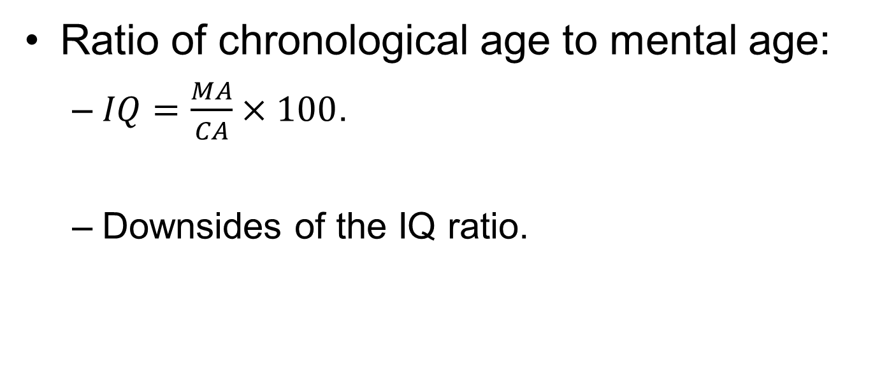
the Stanford–Binet Intelligence Scale (3 of 6)
Ratio of chronological age to mental age:
  $IQ=\frac{MA}{CA}×100$.
  Downsides of the IQ ratio.
Notes:
The ratio of chronological age and mental age allows one to know whether someone is behind, even with, or ahead of his or her chronological age.
For instance, if the chronological age of an individual is 10 years (120 months) and mental age is 10.5 years (126 months), the ratio would be 1.05.
When this number is multiplied by a 100, the result obtained gives the IQ of the individual (which in this case is 105).
This can be represented as,
$$IQ=\frac{MA}{CA}×100=\frac{126}{120}×100=105$$
Therefore, if one’s mental and chronological age are equal, then one’s IQ score is 100 and thus the average IQ became 100.
Downsides of the IQ ratio:
This approach to determining the IQ was never embraced.
This is because the upper limit depends on the upper age limit for the test.
For instance, if the items go up only to an age level of 21, anyone with a chronological age of greater than 21 has to have an IQ of less than 100.
Therefore, intelligence is not thought of IQ and more descriptive and informative terms for describing someone’s level of intelligence are used.

Slide 18
The Stanford–Binet Intelligence Scale (4 of 6)
The uses of SB5 test.
Factors assessed by Stanford-Binet.
Avoiding cultural bias in task and item selection.
Notes:
The uses of SB5 test:
In over the last 100 years, Stanford-Binet has undergone many different versions and currently the fifth edition of the Stanford-Binet (SB-5) is used.
Some of the potential uses (as listed by the publisher’s website) are:
clinical and neuropsychological assessment,
early childhood assessment,
evaluation for special education placements,
adult social security and workers’ compensation evaluations, and
research on abilities and aptitudes.
Factors assessed by Stanford-Binet:
Stanford–Binet assesses five different factors: fluid reasoning, knowledge, quantitative reasoning, visual-spatial processing, and working memory.
These areas are an outgrowth of the fluid, crystallized, and memory focal points mentioned earlier.
When each of these areas is assessed and scored separately, 10 subtests are obtained.
In the end, each individual test taker has a score for verbal and nonverbal performance and a full-scale IQ.
Avoiding cultural bias in task and item selection:
The newer editions of the Stanford-Binet, and most other intelligence tests, have been developed with regard to avoiding cultural bias in task and item selection.
Many strategies are used for this purpose and using a representative sample of people on which to norm the instrument and choose items and statistical analyses to identify and remove sources of bias is one among them.
The way the Stanford-Binet test is administered is administered is important, because it provides a basis for how most types of intelligence tests are given.

Slide 19
The Stanford–Binet Intelligence Scale (5 of 6)
Administering the Stanford–Binet (and Other Tests of Intelligence)
Assessing intelligence regardless of model.
Basal age: lowest point on the test.
Ceiling age: the test taker’s limit.
Notes:
Assessing intelligence regardless of model:
Some strategies that can be used to assess someone’s level of intelligence, regardless of the different models of intelligence.
One such strategy is to challenge the person with more and more difficulty tasks until they aren’t successful and then assign a score based on how far they got.
Most intelligence tests take this approach and these tests begin with some pretty easy questions and tasks to find a starting point and then begin to look at what the individual could do from that point forward.
This range of difficulty helps define the starting and ending points in the scoring of performances on such tests as the Stanford–Binet.
Basal age:
The basal age is the lowest point on the test where the test taker can pass two consecutive items that are of equal difficulty.
At this point, the test taker is on firm ground and could pass all the items that are less difficult.
Ceiling age:
The ceiling age is the point where at least three out of four items are missed in succession and the test taker upon going further would probably give additional incorrect responses.
It is the test taker’s limit, and time to stop.

Slide 20
The Stanford–Binet Intelligence Scale (6 of 6)
Stephen Gould’s view about intelligence.
Example: testing IQ of immigrants seeking political asylum.
Notes:
Gould’s view about intelligence:
Stephen Gould was a great Harvard historian of science and paleontologist.
He wrote a classic book titled The Mismeasure of Man.
In this book he explains that IQ scores are a terrible tool for classifying people.
Example:
Gould discussed the example of how World War II Eastern European immigrants were given IQ tests as they arrived seeking political asylum.
Most of them failed the tests and were sent back home where they died brutally.
The reason why so many people failed was that they did not speak English which is the language of the test.
Therefore, one should keep in mind that intelligence scores are often as much about the format of the test as it is about everyday human behavior.

Slide 21
Most Used Tests (1 of 6)
The five most widely used intelligence tests.
Features of these tests:
  Strong theoretical background.
  Utility in the testing world,
Notes:
The five widely used intelligence tests:
There are five widely used intelligent tests that require years of training to administer and score successfully.
They are Wechsler Adult Intelligence Scale (WAIS), Stanford–Binet Intelligence Scale (S-B), Kaufman Assessment Battery for Children, Slosson Full-Range Intelligence Test (S-FRIT), and McCarthy Scales of Children’s Abilities (MSCA).
Features of these tests:
These above mentioned tests take training to learn how to administer and score.
They have a strong theoretical background and utility in the testing world.
Therefore, they are accepted as valid when used correctly.

Slide 22
Most Used Tests…(2 of 6)
The Weschler Adult Intelligence Scale (WAIS):
  Purpose and ages tested.
  Conceptual framework of the test.
  Interesting points about the test.
Notes:
Purpose and ages tested:
The 4th edition of the test is most recently used.
There are also Wechsler scales for children and even for preschoolers.
WAIS is designed to assess intellectual ability by testing verbal skills and performance.
There is also a verbal comprehension index, a perceptual organization index, a working memory index, and a processing speed index.
The test can be used between ages 16 through 89 years.
Conceptual framework of the test:
Wechsler viewed intelligence as a merging of the general factor (g) coupled with distinct abilities.
His practical emphasis was on the ability to act with a purpose in mind and to think in a logical manner.
Interesting points about the test:
The latest sample used for standardization matches 1995 census data with respect to gender, socioeconomic status, race and ethnicity, educational attainment, and geographical residence.
It is the oldest and most frequently used adult intelligence test.
David Wechsler, the author of the original test, studied with Simon (of the Simon-Binet Scale) in Paris, and some 30 years later, Wechsler started the development of his own test.
Based on a common sense view of intelligence, where intelligent behavior is behavior that is adaptive and useful.

Slide 23
Most Used Tests (3 of 6)
Stanford–Binet Intelligence Scale (S-B):
  Purpose and ages tested.
  Conceptual framework of the test.
  Interesting points about the test.
Notes:
Purpose and ages tested:
The Stanford–Binet Intelligence Scale is designed as “an instrument for measuring cognitive abilities that provides an analysis of the pattern as well as the overall level of an individual’s cognitive development.
It provides 20 scores for verbal reasoning, abstract-visual reasoning, quantitative reasoning, and short-term memory.
The test can be used from 2 years of age through adulthood.
Conceptual framework of the test: It focuses on both verbal and nonverbal tests of intelligence.
Interesting points about the test:
It uses adaptive testing procedure, where test takers answer only those items whose difficulty is appropriate for their performance level.
It uses standard age scores for comparison between test takers.
The vocabulary subtest is given first to help identify a starting place for other tests.

Slide 24
Most Used Tests (4 of 6)
Kaufman Assessment Battery for Children (K-ABC):
  Purpose and ages tested.
  Conceptual framework of the test.
  Interesting points about the test.
Notes:
Purpose and ages tested:
The current edition of the test used is KABC-II NU.
The K-ABC assesses cognitive development in 16 subtests. Some of them are: Magic Window, Face Recognition, Hand Movements, Gestalt Closure, etc.
The test is used for individuals between the ages of 2.5 and 12.5 years.
Conceptual framework of the test:
The subtests of K-ABC are grouped into categories for those that require sequential processing of information and those that require simultaneous processing.
The test taker gets separate global scores for each.
This is basically an information-processing approach.
Interesting points about the test:
Nonverbal scale and non-English-speaking scale are available.
Lots of pictures and diagrams are included among the items.
Sociocultural norms for race and parental education were developed and can be used along with other norms.

Slide 25
Validity and Reliability
Validity is a unitary concept.
Validity and intelligence tests.
Reliability and intelligence tests.
Notes:
Validity is a unitary concept:
All types of validity arguments and evidence can come into play in determining validity of a measure.
However, certain validity approaches seem particularly important for different tests with different purposes.
Validity and intelligence tests:
Intelligence tests are designed to measure the very complex and abstract construct called intelligence.
Validity discussions about the construct focusses on whether it is defined correctly, if the assumed dimensionality of the construct is accurate and if the items and subscales are consistent with those dimensions.
One may think that debates about validity for an intelligence test center on predictive criterion validity.
But developers always make sure that one knows that intelligence is not the same thing as achievement.
Reliability and intelligence tests:
In terms of reliability, intelligence tests are “high-stakes tests.”
This means that there is very little randomness in scores.
Since these tests are made up of many subtests and many items and these items tend to correlate together, the tests demonstrate very high internal consistency reliability.
Also, since intelligence is considered a stable trait that doesn’t change much as children grow older, so test-retest reliability is critical.

